Slide 1

Machine Learning Framework
for Flood Detection
~ Developed by Team Karma (Harsh Bardhan Mishra, Hrituraj Sutradhar and Rahul Singh)

Slide 2

What is Machine Learning?
01
What is Internet of Things?
02
Review the Code
Technologies Utilized
TABLE OF CONTENTS
04
03
Further Improvements
05
Conclusion
06
Let’s get started with Machine Learning
Get started with IoT
Getting on with the various ML Models that we have implemented
Various technologies and Frameworks utilized
What new we can add to this framework
The Final End!

Slide 3

01
What is Machine Learning?
“Computers are able to see, hear and learn. Welcome to the future.”
~Dave Waters

Slide 4

Standard Definition
Machine Learning: A computer is able to learn from experience without being specifically programmed.
It is a subset of Artificial Intelligence where mathematical models are implemented which can be trained using training data to yield an outcome that can be used to make predictions and analysis.

Slide 5

Types of Machine Learning
AI
AI is a super-set to a varied set of technologies like ML/DL
Machine Learning
Machine learning will automate jobs that most people thought could only be done by people
Supervised
Unsupervised
Input is mapped to the Output and training is done for regression and classification
Data is distributed in the model where input is unknown

Slide 6

02
What is Internet of Things?
“If you think that the internet has changed your life, think again. The Internet of Things is about to change it all over again!”
~Brendan O’Brien

Slide 7


IN DEPTH
What is IoT?
IoT is a new revolution in the Internet landscape where gadgets connected to Internet are connected at the Physical Layer and can co-communicate using a Network Layer, finally passing on the data to the Application Layer where the data can be processed and presented for vital statistics.

Slide 8

Lets the numbers speak for themselves…..
20.4 Billion
$15 Trillion
127
IoT Devices by 2020
Amount of Investment by 2025
Devices connecting every second

Slide 9

Layers in IoT
Physical Layer
Networking Layer
Application Layer
Passes the Data from Physical Layer to the Application Layer using a Module with secure Data-Link
Gather Data from Sensors and Actuators performing Data Collection and Segregation
Data is finally disseminated and presented in a clean and concise form for presentation

Slide 10

03
Technologies Utilized
The whole idea is not about the choice between using or not using technology. The challenge is to use it right.
~Cory Doctorow

Slide 11

Technologies and Frameworks
Tipping Bucket Rain Gauge
Raspberry Pi-3
GSM Module
Data Layer
Processing Layer
Web Application
Measure the amount of rainfall by means of a tipping bucket and includes a siphon to measure the rainfall level
A Microcontroller Chip will be used to collect data from a wide range of sensors and APIs where the Machine Learning algorithms can be implemented.
Acts as the Networking Layer utilizing a Satellite-based Telemetry where the data is seamlessly integrated and stored onto Data Centres
Data Layer has been implemented on a Cloud Server wherein large amounts of data can be stored onto a “Cloud” which can then be accessed and processed as per our needs.
Processing Layer comprises of the Machine Learning Model that we have implemented and allows the data to be processed and let inferences be drawn from it.
Web Application has been implemented using ‘Flask’ which is a Python framework which allows for the data to be accessed in real-time from the Web and showcased to the user.

Slide 12
Machine Learning Model Efficiency
 | KNN | DT | LM | RF
Accuracy | 79.16% | 58.33% | 91.67% | 58.33%
Recall | 71.42% | 71.42% | 85.71% | 71.42%
ROC | 80.71% | 55.71% | 92.85% | 55.71%

Slide 13

04
Review the Code
“Give a man a program, frustrate him for a day. Teach a man to program, frustrate him for a lifetime.”
~Muhammad Waseem

Slide 14
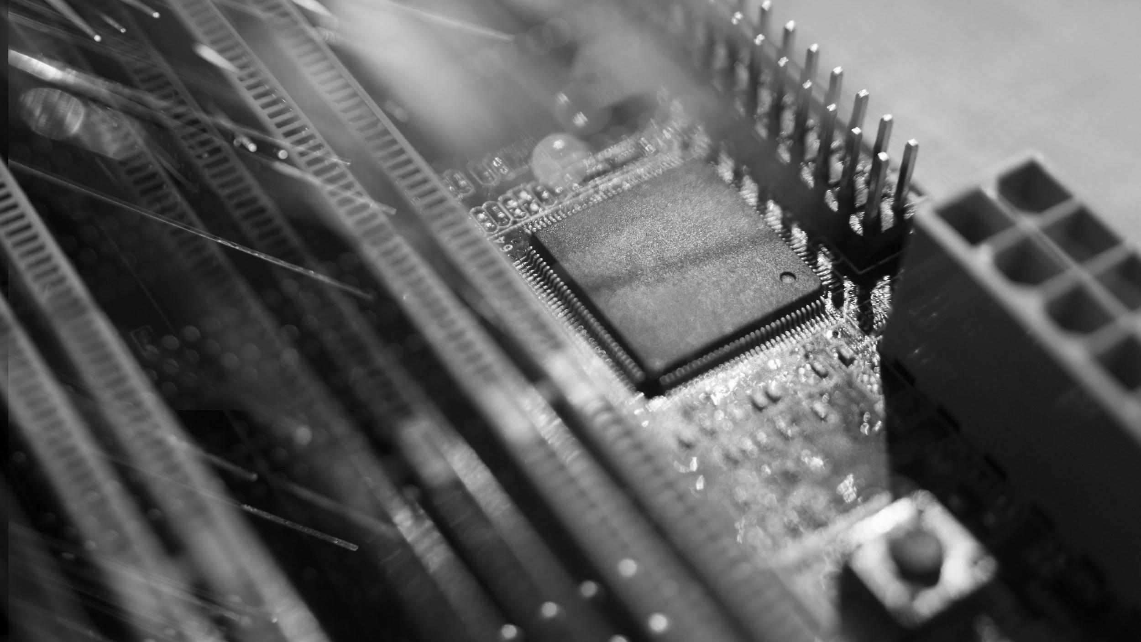
“Talk is cheap. Show me the Code”.
~Linus Torvalds

Slide 15

05
Further Improvements
“Make it work, make it right, make it fast.”
~ Kent Beck

Slide 16
What more we can add?
Use TerraSAR-X synthetic aperture radar data
Data Collection via Remote-Sensing Satellites
Data Collection by Ultrasonic Sensors
Topographical
Data Collection for better analysis
Implement Mobile Application to be used by citizens

Slide 17

06
Conclusion
An end is only a beginning in disguise.
~Craig D. Lounsbrough

Slide 18
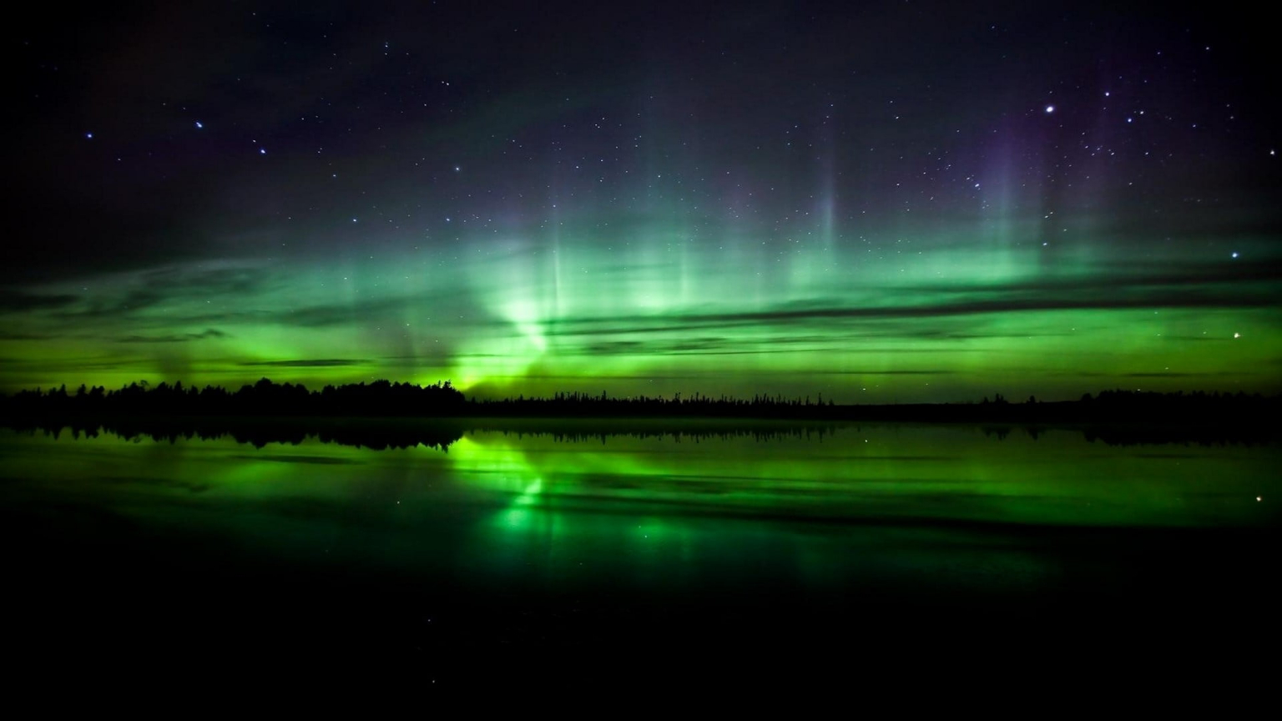
Thanks
Github Repo: github.com/HarshCasper/Badh
Do{
Use Computer
}
While(You==Awake)

Slide 19
Team Karma

